Slide 1
Member meeting The Norwegian Association of Researchers @ USN
Tony Burner

Slide 2
Agenda
1) Welcome - local board - wage negotiations
- other things we’re working with: 2) economic compensation corona 3) health and safety rep. 4) work plans 5) future plans

Slide 3
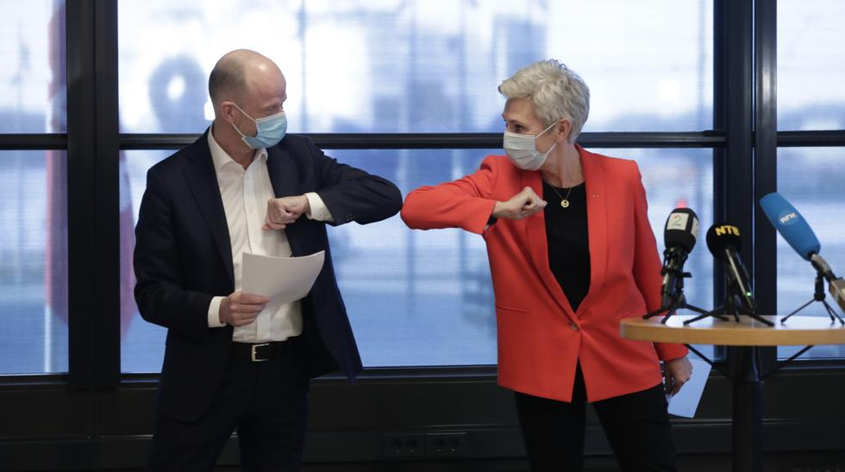
USN- Wage negotiations 2021
Decrease wages
Ensure buying power

Slide 4
Local / central negotiations

Slide 5
Distribution
Ltr 19 – 101: 0,9% plus kr 1.500,-
Ltr 19 – 50: kr 4.000,-
Ltr 51 – 69: Decrease with kr 200,- pr ltr ltr 51: kr 3.800,- ltr 52: kr 3.600,- : : Ltr 69: kr 200,-

Slide 6
Examples:
Ltr 40: 0,9% + 1.500,-+4.000,-
Ltr 60: 0,9% + 1.500,- + 2.000,-
Ltr 80: 0,9% + 1.500,-

Slide 7
Examples:

Slide 8
Local negotiations
Due 31.10.2021

Slide 9
Locally @ USN
The local unions have together formed a suggestion
Ensure buying power for everyone: general increase for all, except certain groups (employed last 12 months, contract running out in July 2022, or working in less than 25% position)
Saves time and energy
Individual 2.5.3. negotiations if necessary

