Slide 1
Forskerforbundet- USN The Norwegian Association of Researchers
September 16, 2020

Slide 2
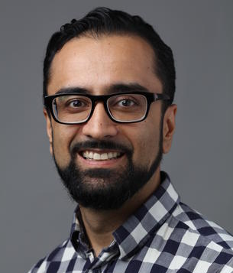
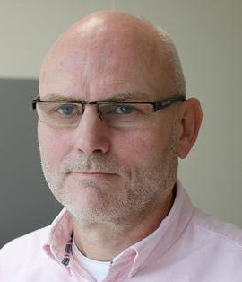
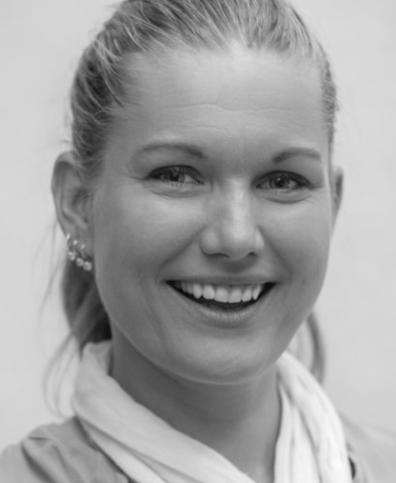
Members of the local board
Drammen, Kongsberg
Notodden,Bø
Elsa Kristiansen
Tony Burner
Idar Vassli
Inger Lise Bergan
Lars Johansen
Solfrid Bratland-Sanda

Slide 3
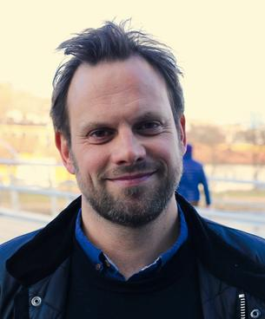
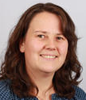
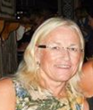
Members of the local board
Vestfold
Ringerike
Sigurd Hareide
Sigurd K Guldbrandsen
Pia Guldbrandsøy
Ansgar Ødegård
Berit Bratholm

Slide 4
What’s in it for me?
Representation
Free legal assistance
Social network
Seminars, information and discussion meetings
Competitively priced insurance and banking services

Slide 5
Two areas of immediate interest?
Wage and working conditions - some successful examples - some examples of what we are working with now
Work plan - some questions we receive

Slide 6
Questions and answers? ☺

